Slide 1






CSE-421
Computer Graphics:
2D Transformations
Lecture-01
Lecturer, Varendra University

Slide 2
2D Transformations
“Transformations are the operations applied to geometrical description of
an object to change its position, orientation, or size are called geometric
transformations”.
Given a 2D object, transformation is to change the object’s
Position (translation)
Size (scaling)
Orientation (rotation)
Shapes (shear)

Slide 3
Point Representation
We can use a column vector (a 2x1 matrix) to represent a 2D point.
𝑥
𝑦
Apply a sequence of matrix multiplications to the object vertices.

Slide 4
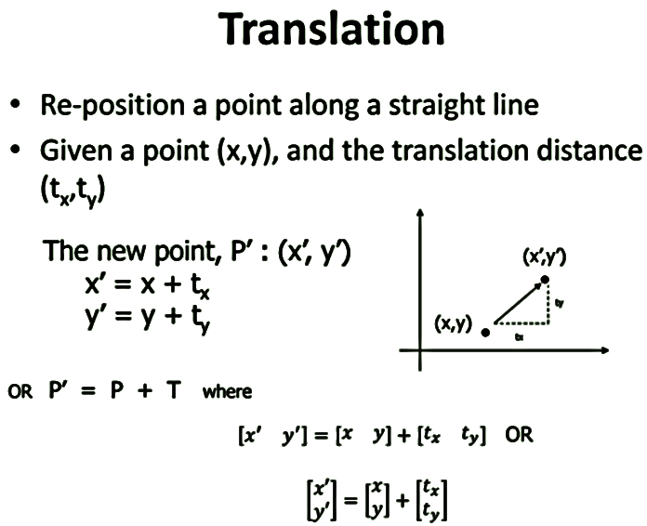

Slide 5
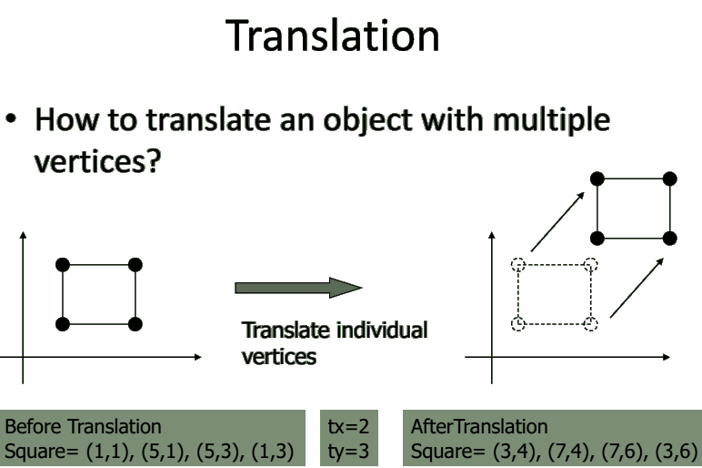

Slide 6
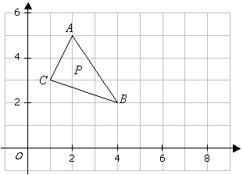

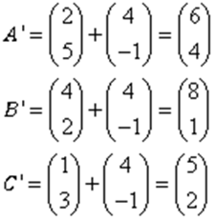
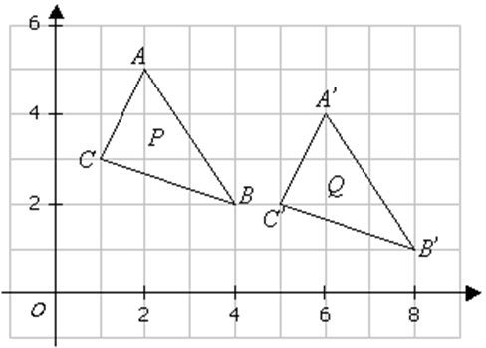
Translation is a process of changing the position of an object in a straight- line path from one coordinate location to another.
.
Example:
The triangle P is mapped onto the triangle Q by the translation
Find the coordinates of triangle Q.
On the diagram, draw and label triangle Q.
Solution:
a)
b)

Slide 7
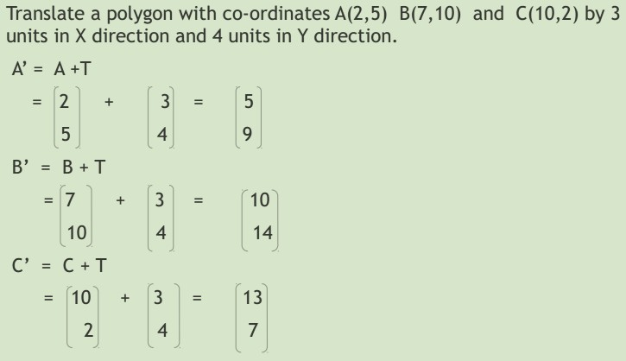
6

Slide 8
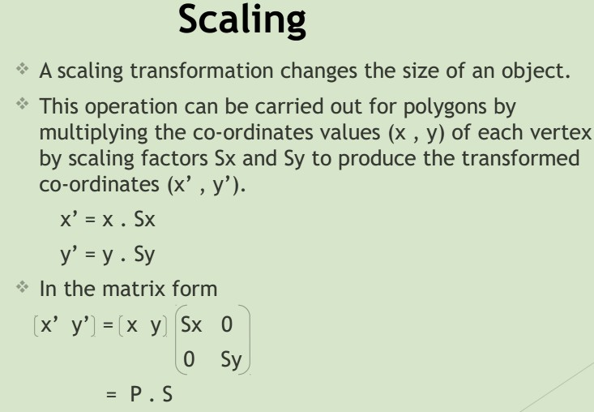

Slide 9
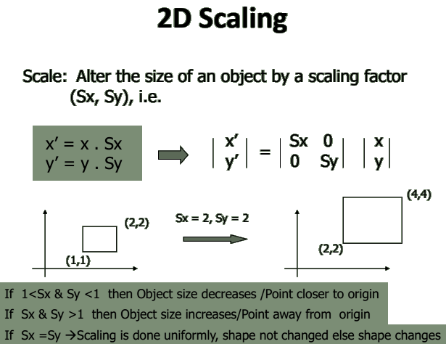

Slide 10
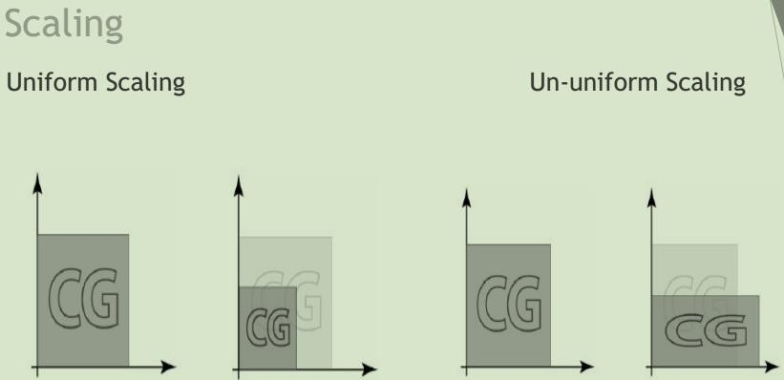

Slide 11
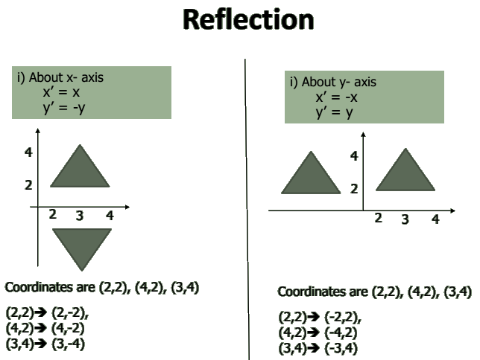

Slide 12
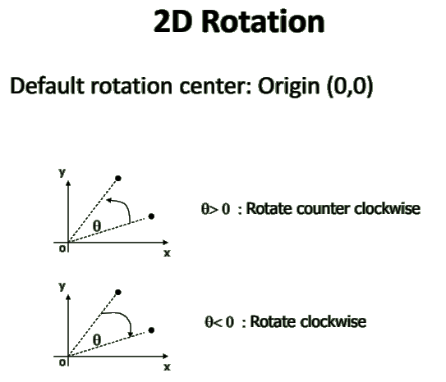

Slide 13
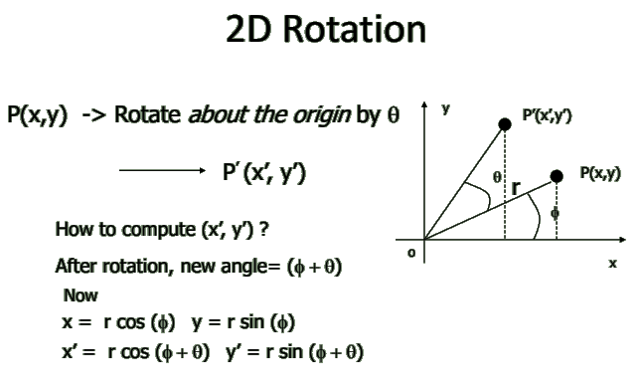

Slide 14
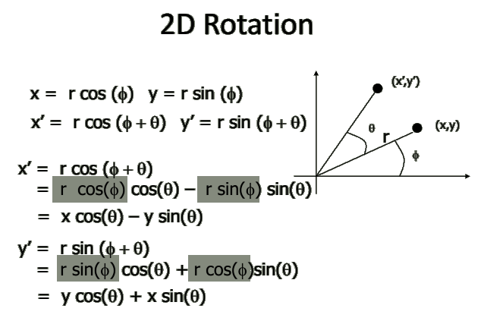

Slide 15
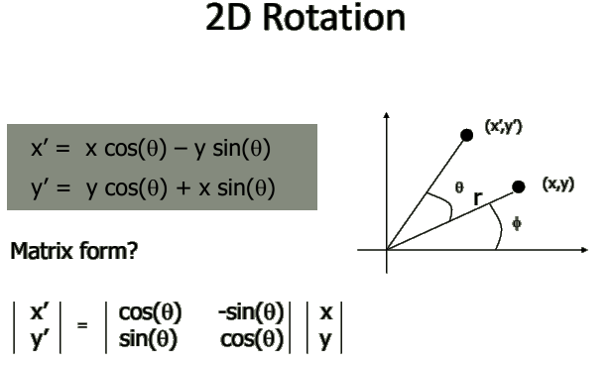

Slide 16
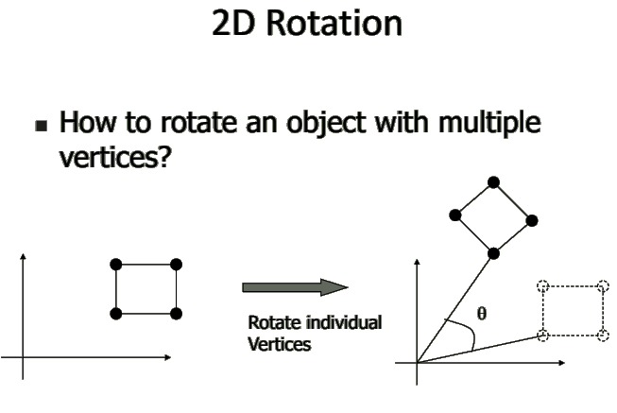

Slide 17
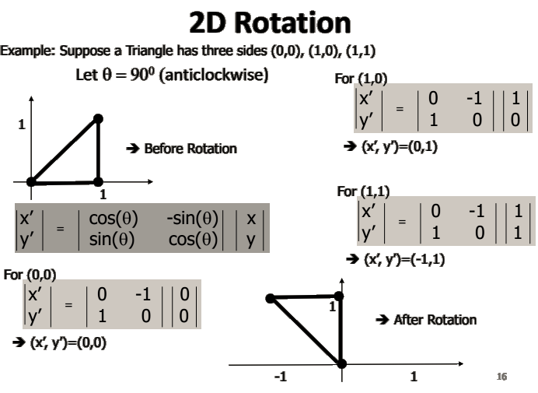

Slide 18
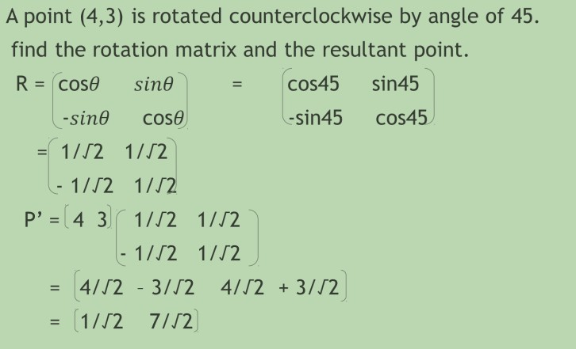
-
-
-
-
4
3

Slide 19
